Slide 1


9th Erasmus Staff Training Week
Gdańsk Tech Library
2025
The world of data: how to improve
the competences of data stewards?
Piotr Krajewski
Marta Kuźma
https://pg.edu.pl/en/openscience

Slide 2



…by practice
Open Research Data Repository
verifing and aproving metadata of datasets submitted for publication in the Bridge of Data repository
curation of datasets collection
improving our repository by:
collaboration with the IT department,​
preparation of user guidelines and instructions,​
participation in the certification processes (e.g., CoreTrustSeal quality certification)

Slide 3
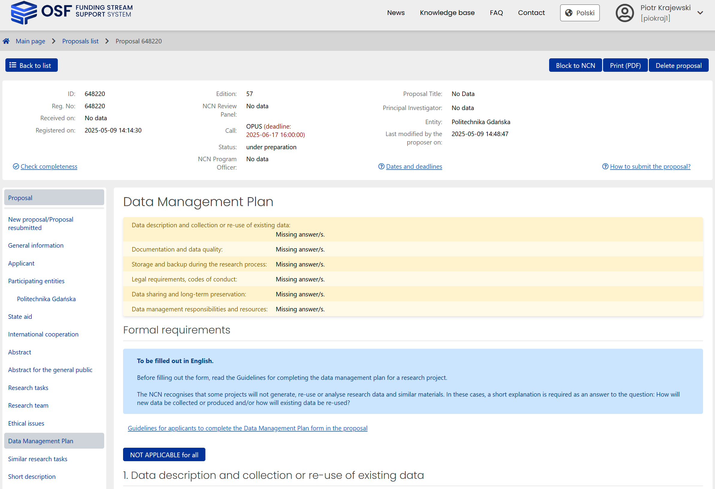
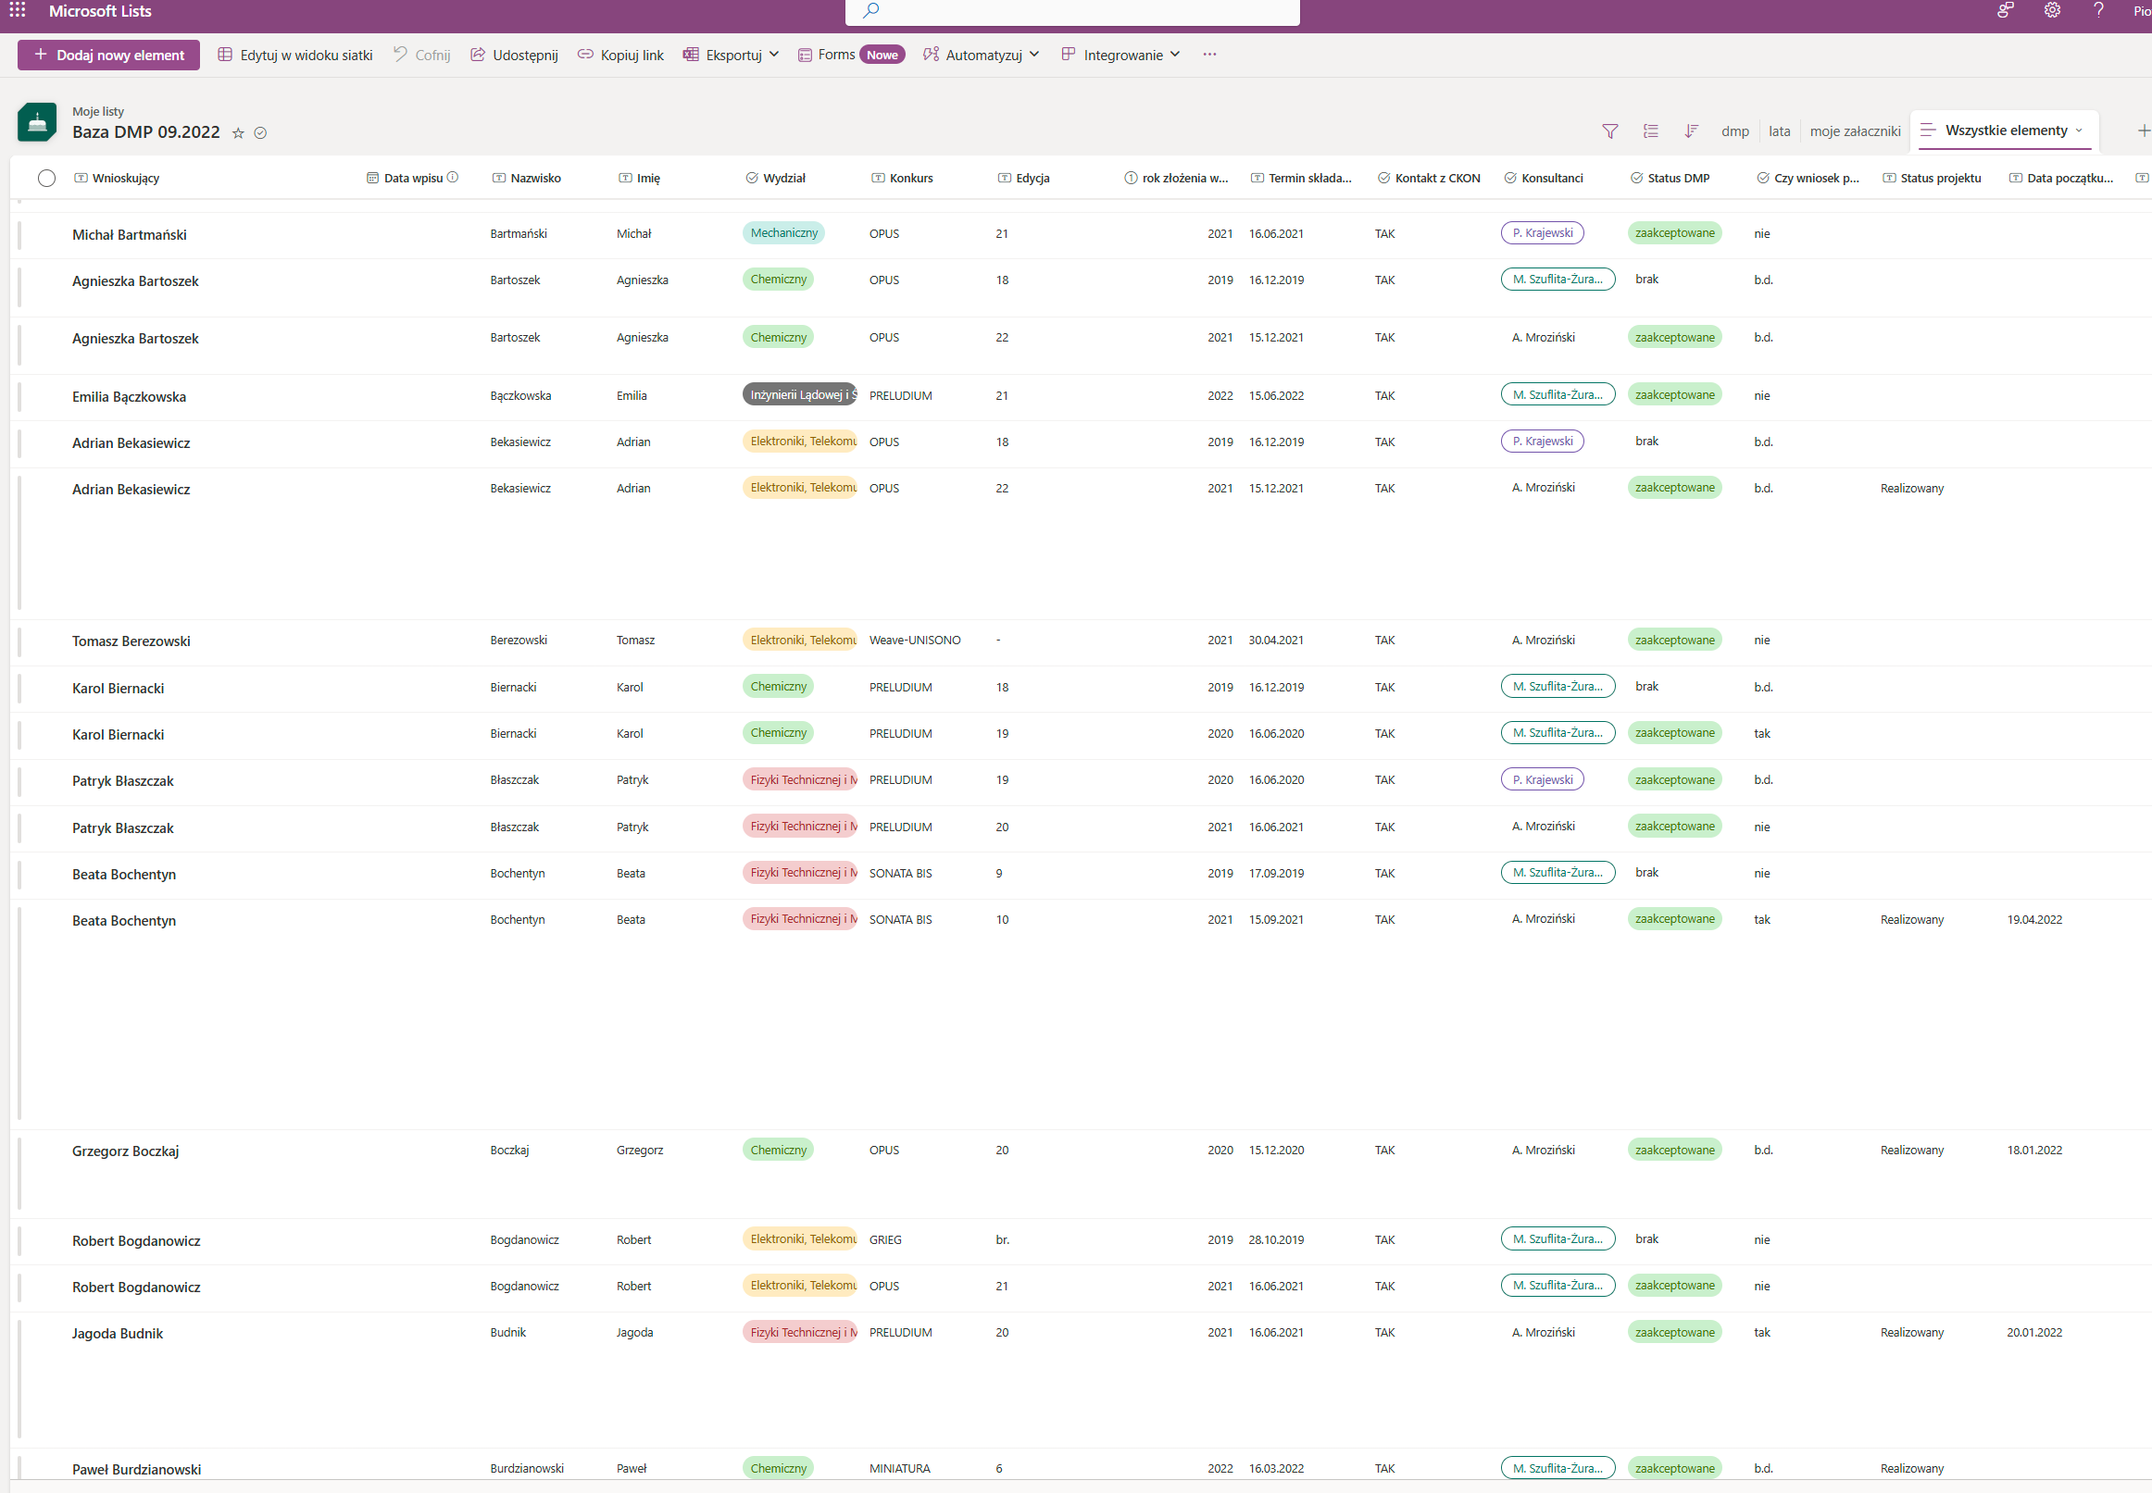
…by practice
Research Data Management support:
• verification of Data Management Plans prepared by Gdańsk Tech researchers as part of applications for National Science Centre grants
• maintenance of a database registering and archiving all verified DMPs
• support for researchers in properly completing project reports (annual and final) in the context of research data sharing
• consultations and training for researchers covering research data management area
• preparation of educational and training materials related to research data

Slide 4
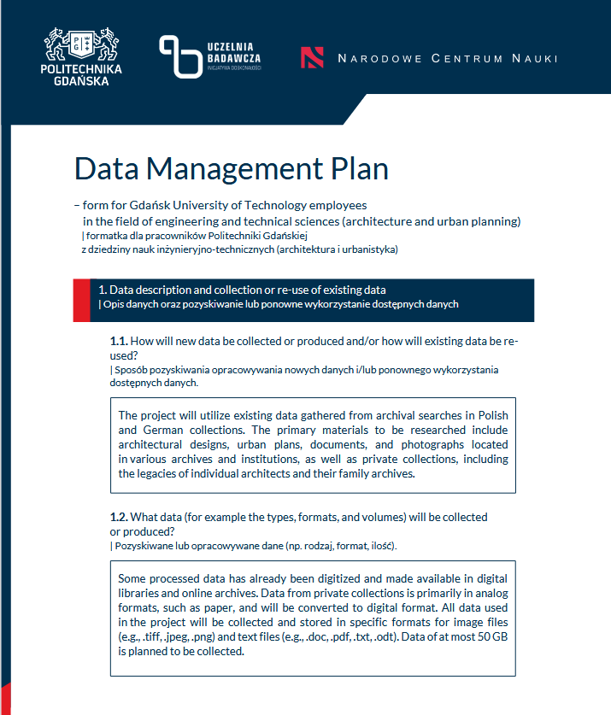
… by participation in projects
Initiative of Excellence – Research University (IDUB)
2024-2025 | Actions to promote and increase awareness of Open Research Data
IDUB activities aim to disseminate effective methods and practices in publishing and sharing research data among the academic community of the Gdańsk University of Technology.
7
7
discipline data stewards
Key goal for this initiative is creating a team of qualified data stewards in response to the need for support for Gdańsk Tech researchers and PhD students focused on the scientific disciplines within which research activities are conducted.
model Data Management Plans
architecture and urban planning
automation, electronics,
electrical engineering
and space technologies
economics and finance
technical informatics
and telecommunications
environmental engineering,
mining and energy
biological sciences
chemical sciences

Slide 5
… by participation in projects
Initiative of Excellence – Research University (IDUB)
2024-2025 | Actions to promote and increase awareness of Open Research Data
322
8
datasets and data descriptors
The activity of data stewards contributes to increasing the quality of scientific research conducted by Gdańsk Tech employees, increasing the number of datasets and research data-related articles published by them, and in the long run, will result in an increase in the visibility of their output in the international arena.

Slide 6
… by participation in tranings
Initiative of Excellence – Research University (IDUB)
2024-2025 | Actions to promote and increase awareness of Open Research Data
5
Competences enhancement: internal and many external trainings
24.05.2024 - Information security
05.11.2024 - Journals publishing data descriptors
21.11.2025 - Data Management Plans creation
06.05.2025 - Research data policy at foreign publishers of scientific journals
12.06.2025 - Storing and archiving large datasets
05-06.09.2024 - Make Data Count Summit 2024
10-12.09.2024 - PUBMET 2024 1st Summer School on Scholarly Communication
since 14.10.2024 - The University of Vienna Data Steward Certificate Course
13-14.02.2025 - Train-the-Trainer Workshop on Research Data Management

Slide 7


A beautiful, modern university with character
https://youtu.be/1q6CMTo1xJI

